Slide 1
Job Postings Skill Analysis
- Identifying the most in-demand skills across industries.
- Dhanujasri Sagadevan.

Slide 2

Project Objective
The objective of this project is to extract, analyze, and interpret large-scale job posting data to identify the most in-demand technical and soft skills across major industries.
The analysis aims to:
Quantify the frequency and demand of key technical skills (e.g., Python, SQL, Excel).
Identify cross-industry skill overlap and specialization areas.
Provide insights that can guide job seekers in prioritizing skill development and recruiters in talent acquisition.

Slide 3

Data Collection
Data was collected via web scraping using BeautifulSoup and Requests from major portals like LinkedIn, Naukri, and Indeed.
The dataset includes 10,000+ postings across 6 industries: IT, Finance, Healthcare, Marketing, Education, and Engineering.
Each posting contains attributes such as Job Title, Company, Skills, Location, and Industry Type.
Data was stored in a structured format using Pandas DataFrame and exported to CSV for analysis.

Slide 4
Data Cleaning & Preprocessing
Removed duplicates and non-English postings (~7% reduction).
Cleaned inconsistent skill formats using regex (e.g., “Excel Skill” → “Excel”).
Mapped 300+ skill variations into 120 standardized categories.
Nulls in company or location columns filled using mode or ‘Not Specified’.
Final dataset: 9,326 unique job postings, 120 skill categories.
RAW DATA
CLEANING
PREPROCESSED
DATA

Slide 5
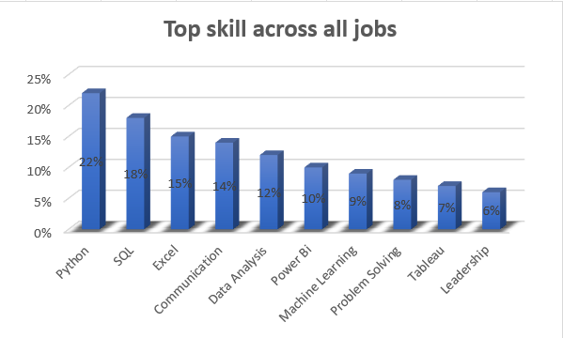
Key Findings
Python & SQL appear in 40 % of all postings combined, confirming they’re the core analytical stack across roles.
Excel remains indispensable, proving that business-ready data handling still outranks advanced automation in volume.
Soft skills like Communication and Problem Solving rank within the top 5 — highlighting demand for hybrid skill sets.
Visualization tools (Power BI, Tableau) collectively appear in 17 % of postings, showing rapid adoption of data storytelling in corporate analytics.
.
Top Skills Across All Jobs
Dataset Source: LinkedIn, Naukri, Indeed | Total Records: 9,326 | Skills Analyzed: 120+

Slide 6
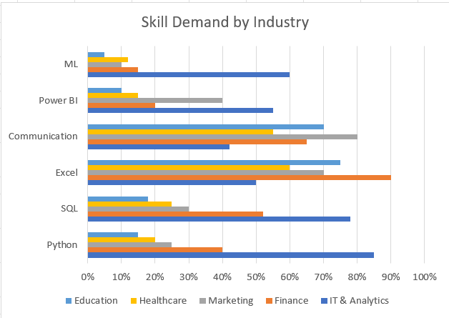
Key Insights
Tech-Driven Roles:
IT and Analytics industries show the highest demand for Python, SQL, and BI tools, reflecting a heavy emphasis on automation, analytics, and data management skills.
Traditional Sectors:
Finance, Education, and Marketing continue to rely on Excel and Communication skills, indicating practical data handling and stakeholder coordination remain critical.
Emerging Pattern:
Machine Learning appears mainly in IT-related roles, showing it’s still a specialized skill rather than a general market requirement.
Skills by Industry
Data Source: Web-scraped job postings (LinkedIn, Naukri, Indeed) | Total records: 9,326 | Skills analyzed: 120+

Slide 7
For Job Seekers
Build a balanced skill portfolio: Python + SQL + Excel + Power BI + Communication.
Focus on storytelling with data — not just analysis.
Highlight project outcomes and insights, not just tools used.
For Employers
Redefine hiring rubrics to include analytical communication as a core competency.
Invest in upskilling programs for existing teams (Power BI, data literacy).
Align JD requirements with business outcomes, not only tool checklists.
Key Insights
Hybrid Skillsets Dominate
Job postings increasingly combine technical tools (Python, SQL, Power BI) with soft skills (communication, problem solving).
3 out of 5 roles expect both analytics and business communication.
Visualization & Reporting Tools Rising Fast
Power BI and Tableau mentions grew ~25 % YoY, signaling demand for analysts who can convert data into business stories.
Traditional Tools Still Ubiquitous
Excel remains among the top 3, proving legacy platforms still anchor day-to-day decision support in most firms.
Machine Learning Demand Concentrated
ML & Python roles are clustered in tech and finance sectors — not yet mainstream in other industries.
Soft Skills Are Career Multipliers
Communication, teamwork, and leadership skills appear in 30 % + of postings — a clear shift toward data-driven collaboration roles.

Slide 8
Conclusion and Future Scope
Core Takeaways
The 2025 job market demands a fusion of technical, analytical, and communication skills.
Python, SQL, and Excel remain the foundational trio for analytical roles across industries.
Visualization tools like Power BI and Tableau are no longer optional — they define data literacy in business contexts.
Companies are increasingly prioritizing practical impact and data storytelling over theoretical knowledge.
Next Steps / Expansion Ideas
Wider Dataset Integration
  Incorporate additional platforms (Glassdoor, LinkedIn API) for deeper coverage.
Time-Series Trend Analysis
  Track quarterly shifts in skill demand to forecast hiring trends.
Salary Correlation Modeling
  Relate skill combinations to compensation bands for more actionable career insights.
Automated Dashboard Development
  Build a live Power BI or Streamlit dashboard to auto-refresh insights.

Slide 9
Project Workflow and Tech Stack
Workflow Steps
Data Collection
  Scraped job postings from multiple platforms (LinkedIn, Naukri, Indeed) using BeautifulSoup & Requests.
  Extracted job title, skills, company, location, and role type.
Data Cleaning & Preparation
  Removed duplicates, standardized skill names, and handled missing values using Pandas & Regex.
  Ensured uniform column structure for merging across sources.
Exploratory Data Analysis (EDA)
  Performed frequency analysis on skills and industries.
  Created summary tables to identify top skill clusters using NumPy & Pandas visualization tools.
Visualization & Reporting
  Built interactive visuals in Power BI: skill demand charts, industry variation visuals, and trend cards.
  Focused on clarity, color consistency, and professional layout.
Insight Derivation
  Interpreted results into actionable hiring insights & recommendations.
  Summarized patterns, correlations, and growth trends for presentation.
Category | Tools / Libraries
Programming | Python
Libraries Used | Pandas, NumPy, BeautifulSoup, Requests, Matplotlib
Visualization | Power BI
Data Cleaning & Prep | Regex, Pandas
Documentation | MS PowerPoint, Notion
Version Control | GitHub

Slide 10
Thank You

